Slide 1
MMA - Datathon

Slide 2
Operational Research
Describe the problem
Design a model
Solve the model
Validate the model
Implement the solution

Slide 3
Describe the Problem

Slide 4
Problem
MMA Management
Think:
Stores are not optimized for the high-demand of Instabasket PS (Personal Shopper)
Want:
Test store format with special Instabasket aisle
Wonders:
Can some suggested set of substitutable products be identified and used by PS?
Expected Outcome:
Most Instabasket orders become fulfilled by top 1000 items in Instabasket aisle.

Slide 5
Task
Analyze the given data (Order - Product – Department – Aisle)
Recommend top 1000 products to place on Instabasked aisle
Given Freezer and Refrigerator constraints
Metrics to Optimize:
Number of orders that use in-aisle items
Average % of items in each order that use in-aisle items
Account for identified substitutes

Slide 6
Design a Model

Slide 7
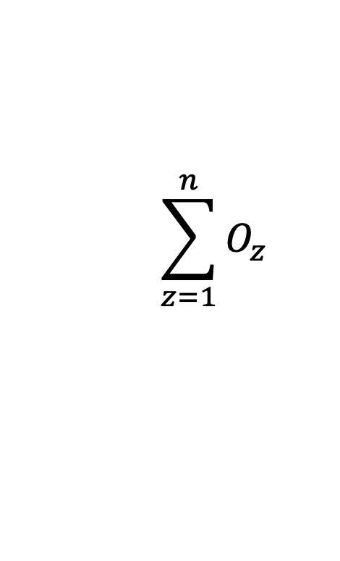

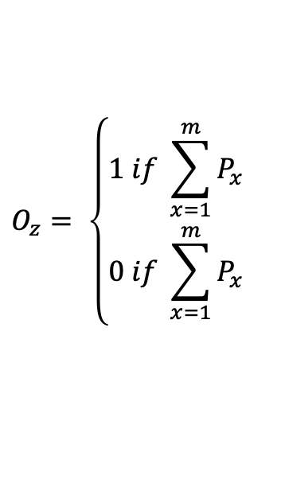
Number of Orders that use in-aisle items
$$\sum_{z=1}^{n}{O_{z}}$$
Where:
z = Order number
n = Total number of Orders
$$O_{z}= \left\{\begin{aligned}1 if \sum_{x=1}^{m}{P_{x}} \\ 0 if \sum_{x=1}^{m}{P_{x}}\end{aligned}\right.$$
Does my order Z contain a product in Instabasket aisle? (1 = yes, 0 = no)
Where:
m = total number of products in order
x = variable iterating until m
$$P_{x=}\left\{\begin{aligned}1 if product X is in aisle \\ 0 if product X isn^{′}t in aisle\end{aligned}\right.$$

Slide 8


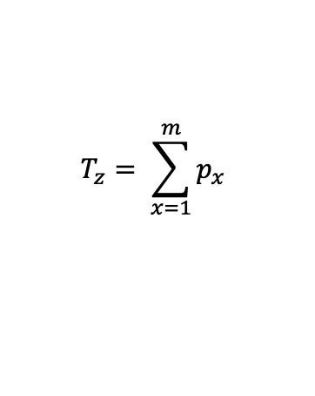


Average % of items in each order that use in-aisle items
PS: Not accounting for substitute products
$$\frac{\sum_{z=1}^{n}{\left(\frac{I_{z}}{T_{z}}\right)}}{n}$$
Where:
z = Order number
n = Total number of orders
= Total number of products In-aisle from order z
= Total number of products in order z
$$I_{z}= \sum_{x=1}^{m}{p_{x}^{} in aisle}$$
$$I_{z}$$
$$T_{z}$$
$$T_{z}= \sum_{x=1}^{m}{p_{x}^{}}$$
Where:
m = total number of products in order z
x = iterable through products in order z
z = iterable through orders

Slide 9
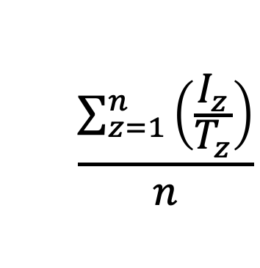
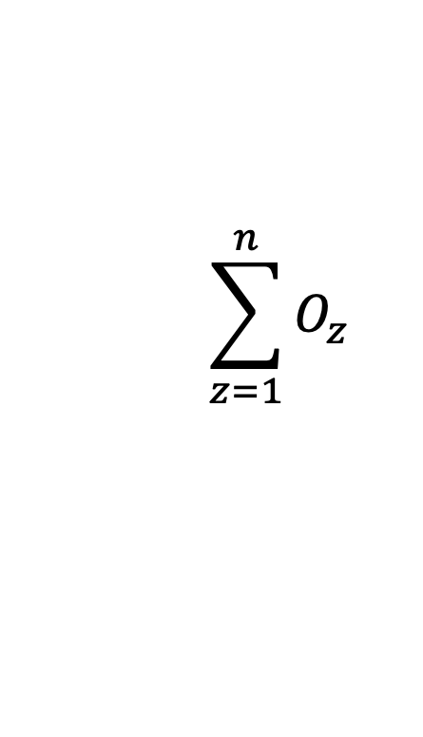

Model
PS: Not accounting for substitute products
Objective Function:
$$\sum_{z=1}^{n}{O_{z}}$$
$$\frac{\sum_{z=1}^{n}{\left(\frac{I_{z}}{T_{z}}\right)}}{n}$$
Max
$$+$$
Constraints:
The number of refrigerated products in-aisle is limited to 100
The number of frozen products in-aisle is limited to 100

Slide 10
Solve the Model

Slide 11
Plan
Use a program with the Simplex method for calculation.
Program: Excel

